Slide 1

DIYAMHOUSEOFSILVER
Instagram Report
BRAND
PERIOD
COMPARISON PERIOD
CHANNEL
@diyamhouseofsilver
18 Jun 2026 - 17 Jul 2026
19 May 2026 - 17 Jun 2026
Instagram

Slide 2

DIYAM HOUSE OF SILVER
EXECUTIVE SUMMARY
2/12
Between June 18 and July 17, 2026, DIYAMHOUSEOFSILVER's Instagram profile experienced modest follower growth, adding 4 new followers, though the growth rate slowed compared to the previous period. The account published 39 posts, a decrease from before, but successfully increased its use of hashtags per post significantly, which contributed to a broader reach and higher total impressions of 5,383.Engagement rates per post and per follower saw a slight decline, indicating somewhat less interaction per post despite the increased visibility. Video views more than doubled, highlighting strong interest in video content, especially reels, which also showed a rise in engagement with 31 reels posted.The earned media value increased to $179, demonstrating growing brand awareness and audience engagement value over the period.
Source: Socialinsider
Date range: 18 Jun 2026 - 17 Jul 2026

Slide 3
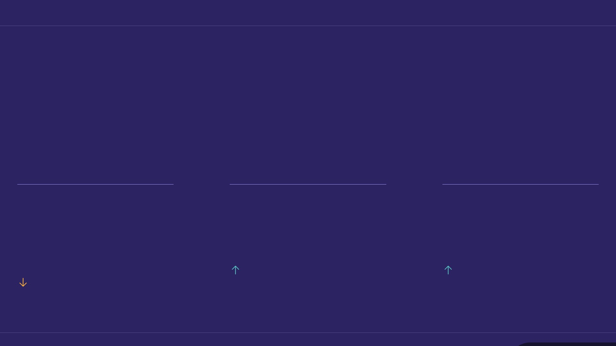
KEY INSIGHTS
3/12
One month, three numbers
Overall a positive period, with some room for improvement.
1.26 %
5,383
3,383
Avg. Engagement Rate by Followers
Organic Posts Views
Organic Posts Reach
57.21%
40.37%
11.59%
Source: Socialinsider
Date range: 18 Jun 2026 - 17 Jul 2026

Slide 4
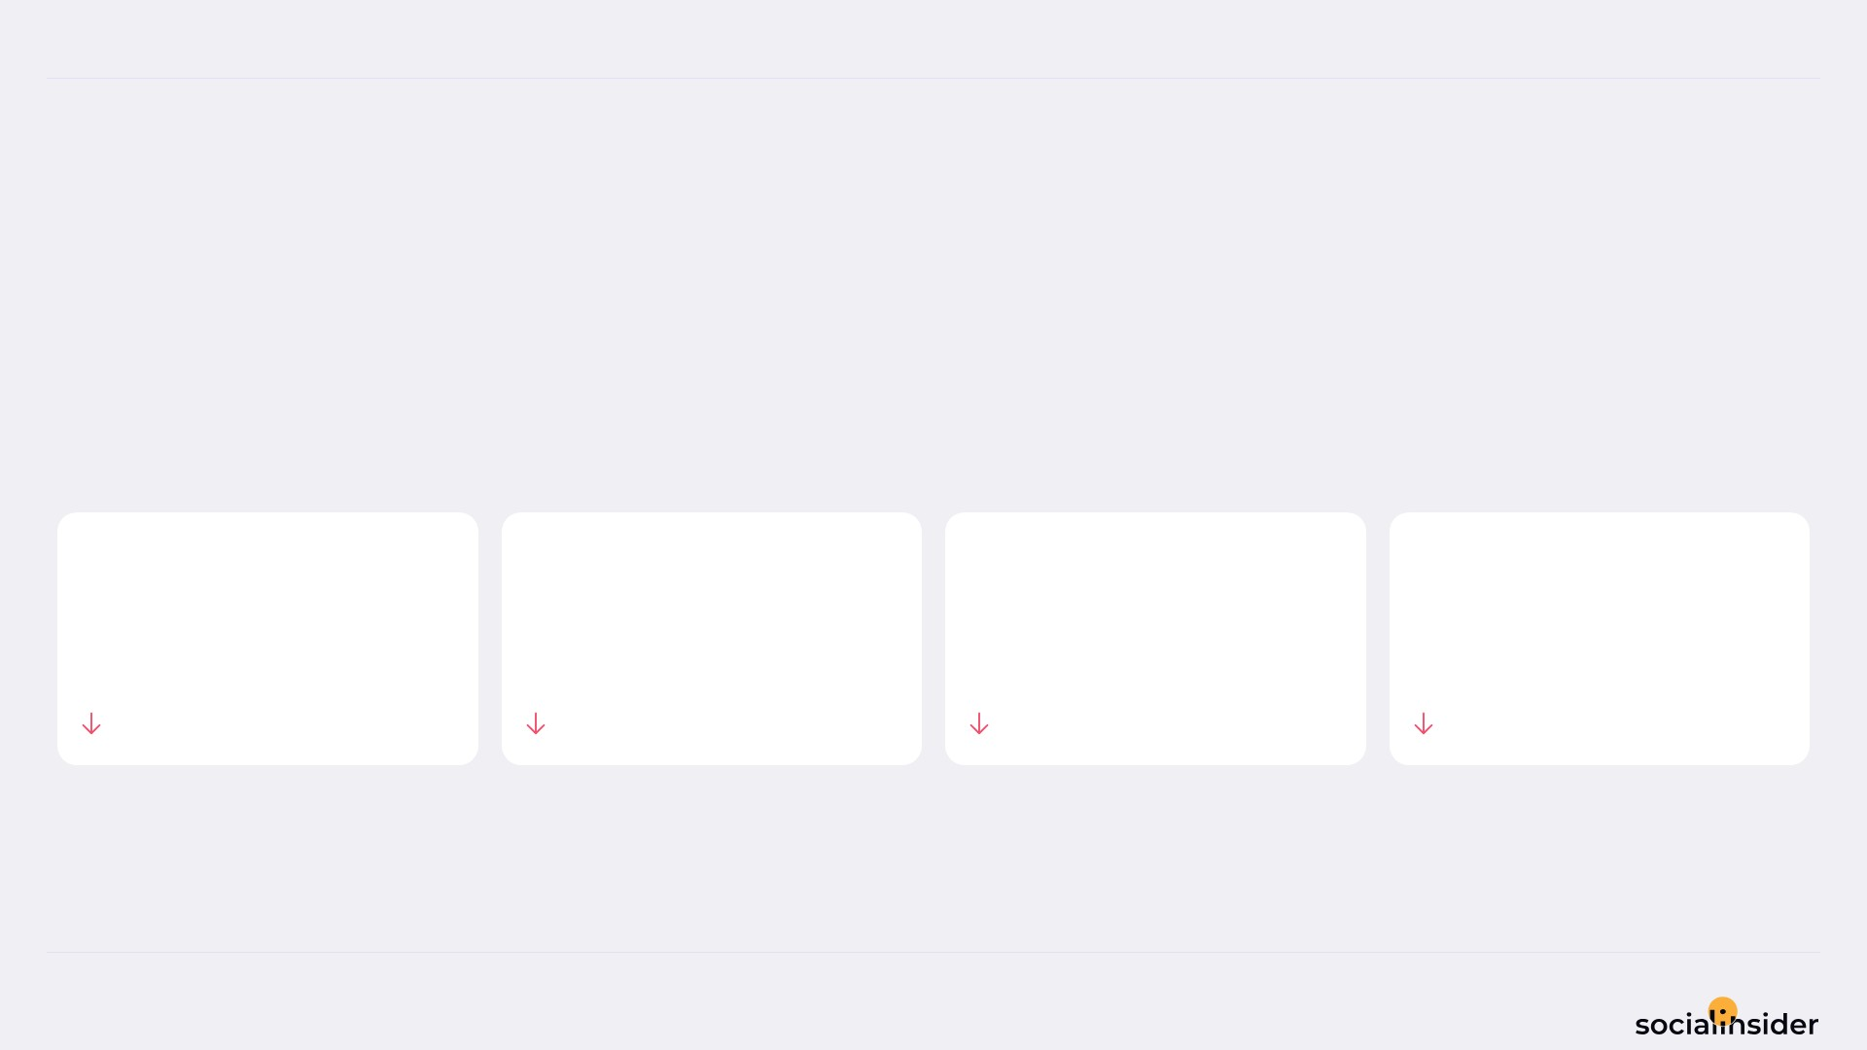
DIYAM HOUSE OF SILVER
POSTS PERFORMANCE
4/12
POSTS TO ENGAGEMENT
We posted 18.75% less, and engagement followed.
TOTAL POSTS
TOTAL ENGAGEMENT
AVG ENGAGEMENT / POST
AVG ENGAGEMENT / DAY
39
138
3.5
4.6
18.75%
26.6%
9.66%
26.6%
Source: Socialinsider
Date range: 18 Jun 2026 - 17 Jul 2026

Slide 5
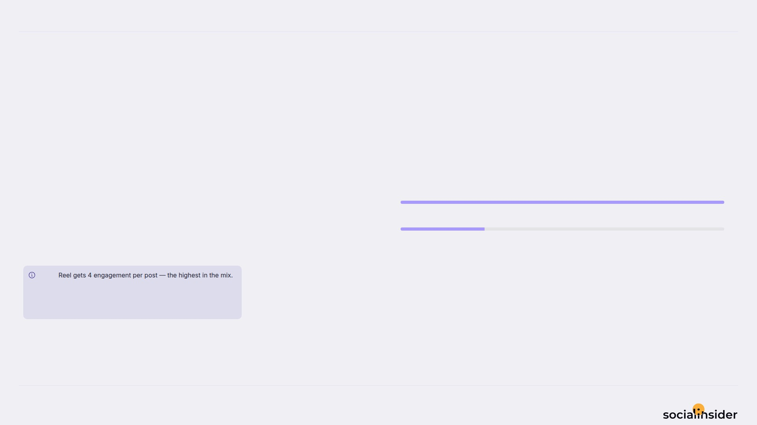
DIYAM HOUSE OF SILVER
5/12
WHAT WE PUBLISHED
Reel made up the majority of posts published during this period.
Reel
31
Reel accounted for 79% of posts and 93% of engagement.
Image
8
Note
Source: Socialinsider
Date range: 18 Jun 2026 - 17 Jul 2026

Slide 6
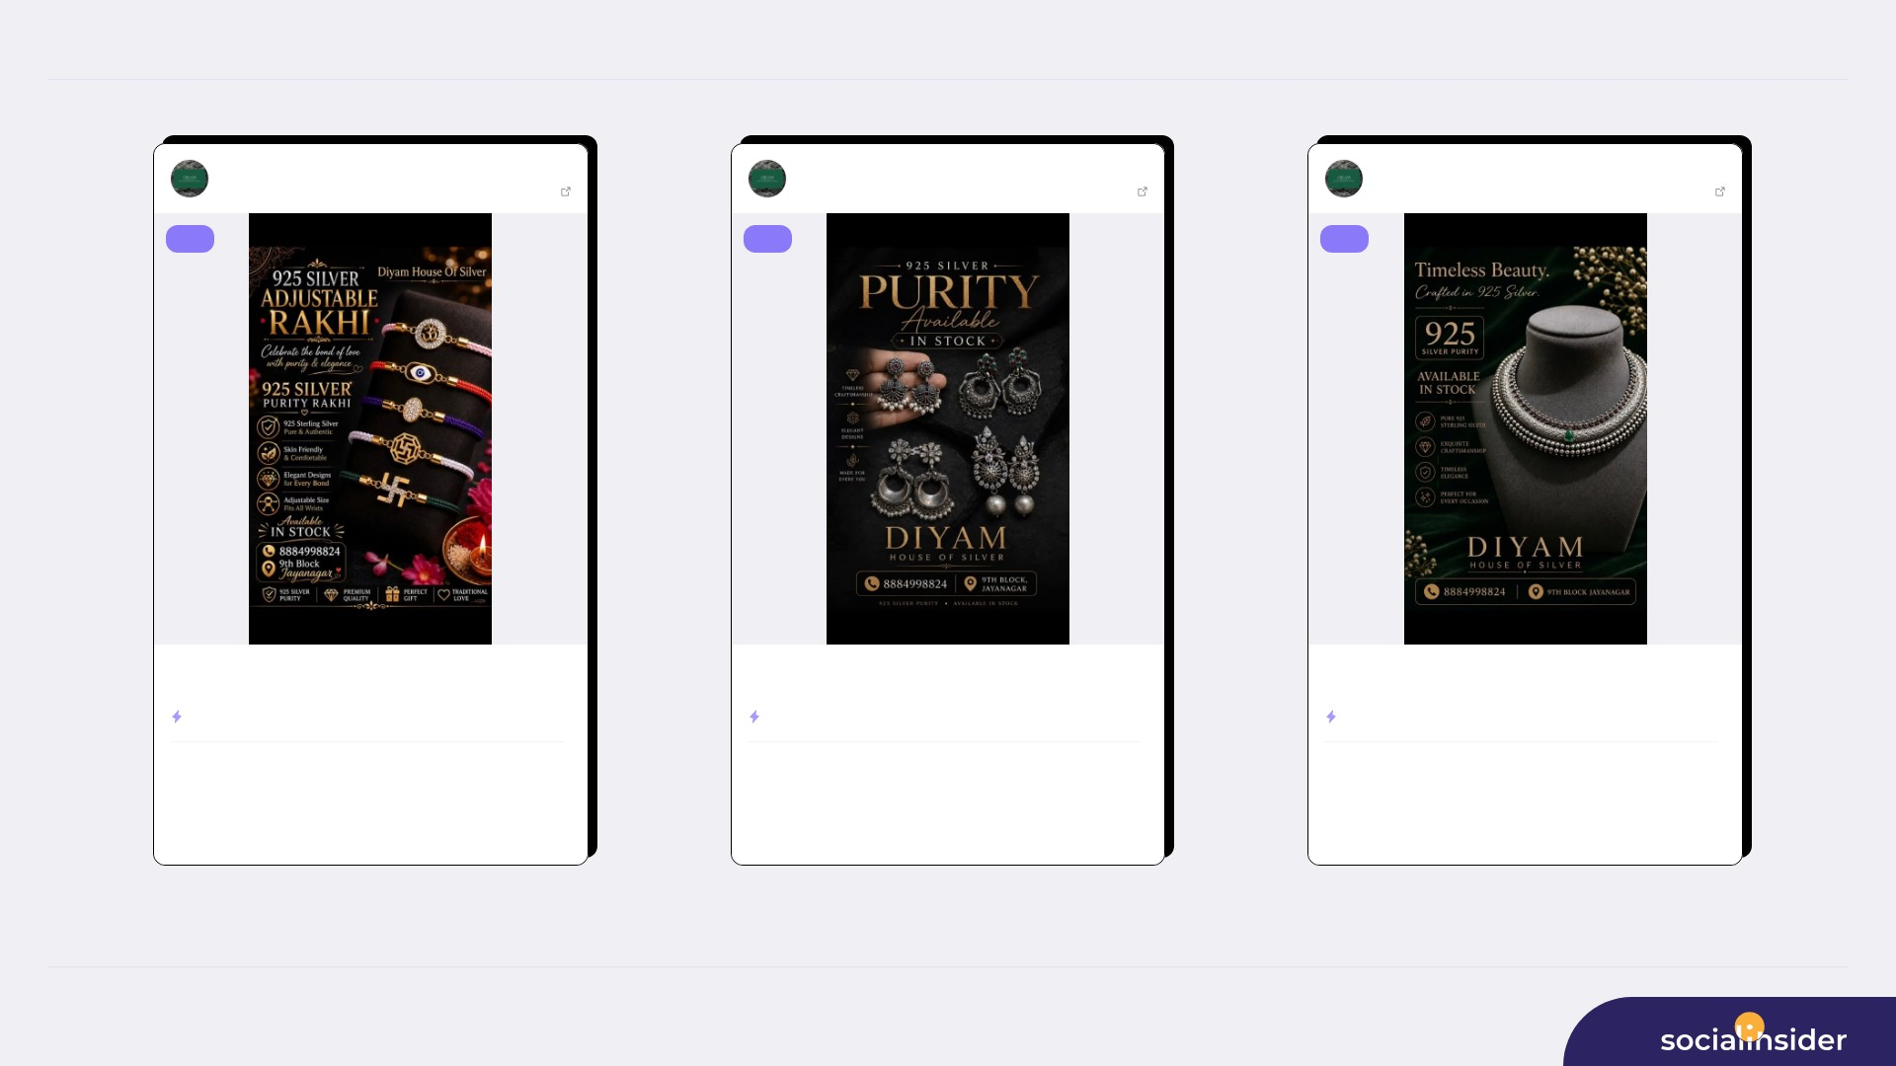
TOP CONTENT
6/12
DIYAM HOUSE OF ...
Jul 02, 2026
DIYAM HOUSE OF ...
Jun 21, 2026
DIYAM HOUSE OF ...
Jun 27, 2026
281 followers
View post
281 followers
View post
281 followers
View post
reel
reel
reel
925 Silver Adjustable Rakhi. Available in stock. Get yours before its ...
925 Silver Earings Oxidise Finish. Available in Stock. For more detail...
925 silver oxadise Necklace. Available in stock. For more details Dm o...
ENGAGEMENT RATE
2.85%
ENGAGEMENT RATE
2.49%
ENGAGEMENT RATE
2.49%
208
7
136
7
192
7
VIEWS
LIKES
VIEWS
LIKES
VIEWS
LIKES
1
130
0
85
0
120
COMMENTS
REACH
COMMENTS
REACH
COMMENTS
REACH
Source: Socialinsider
Date range: 18 Jun 2026 - 17 Jul 2026

Slide 7
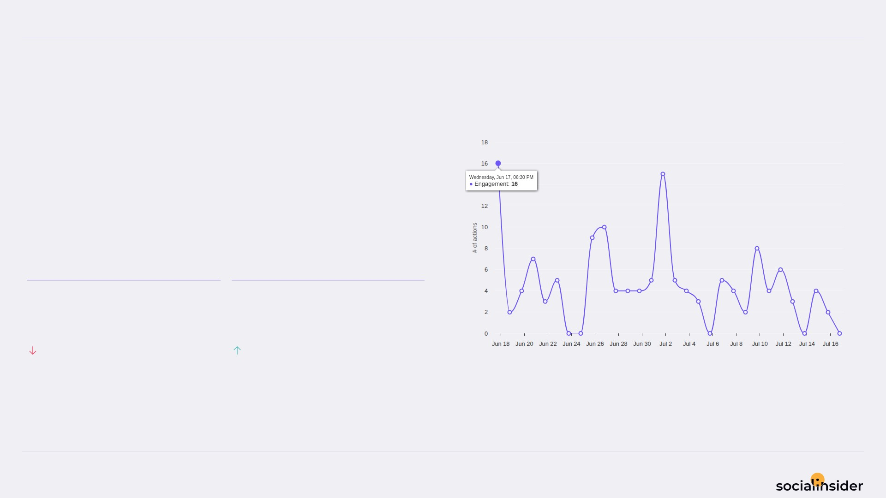
DIYAM HOUSE OF SILVER
ENGAGEMENT
7/12
Engagement trend over the selected period
133 Total Organic Likes — a volatile period.
Total Organic Likes fell while Total Organic Comments held — Total Organic Comments is the bright spot.
TOTAL ORGANIC LIKES
TOTAL ORGANIC COMMENTS
133
5
28.88%
400%
Source: Socialinsider
Date range: 18 Jun 2026 - 17 Jul 2026

Slide 8
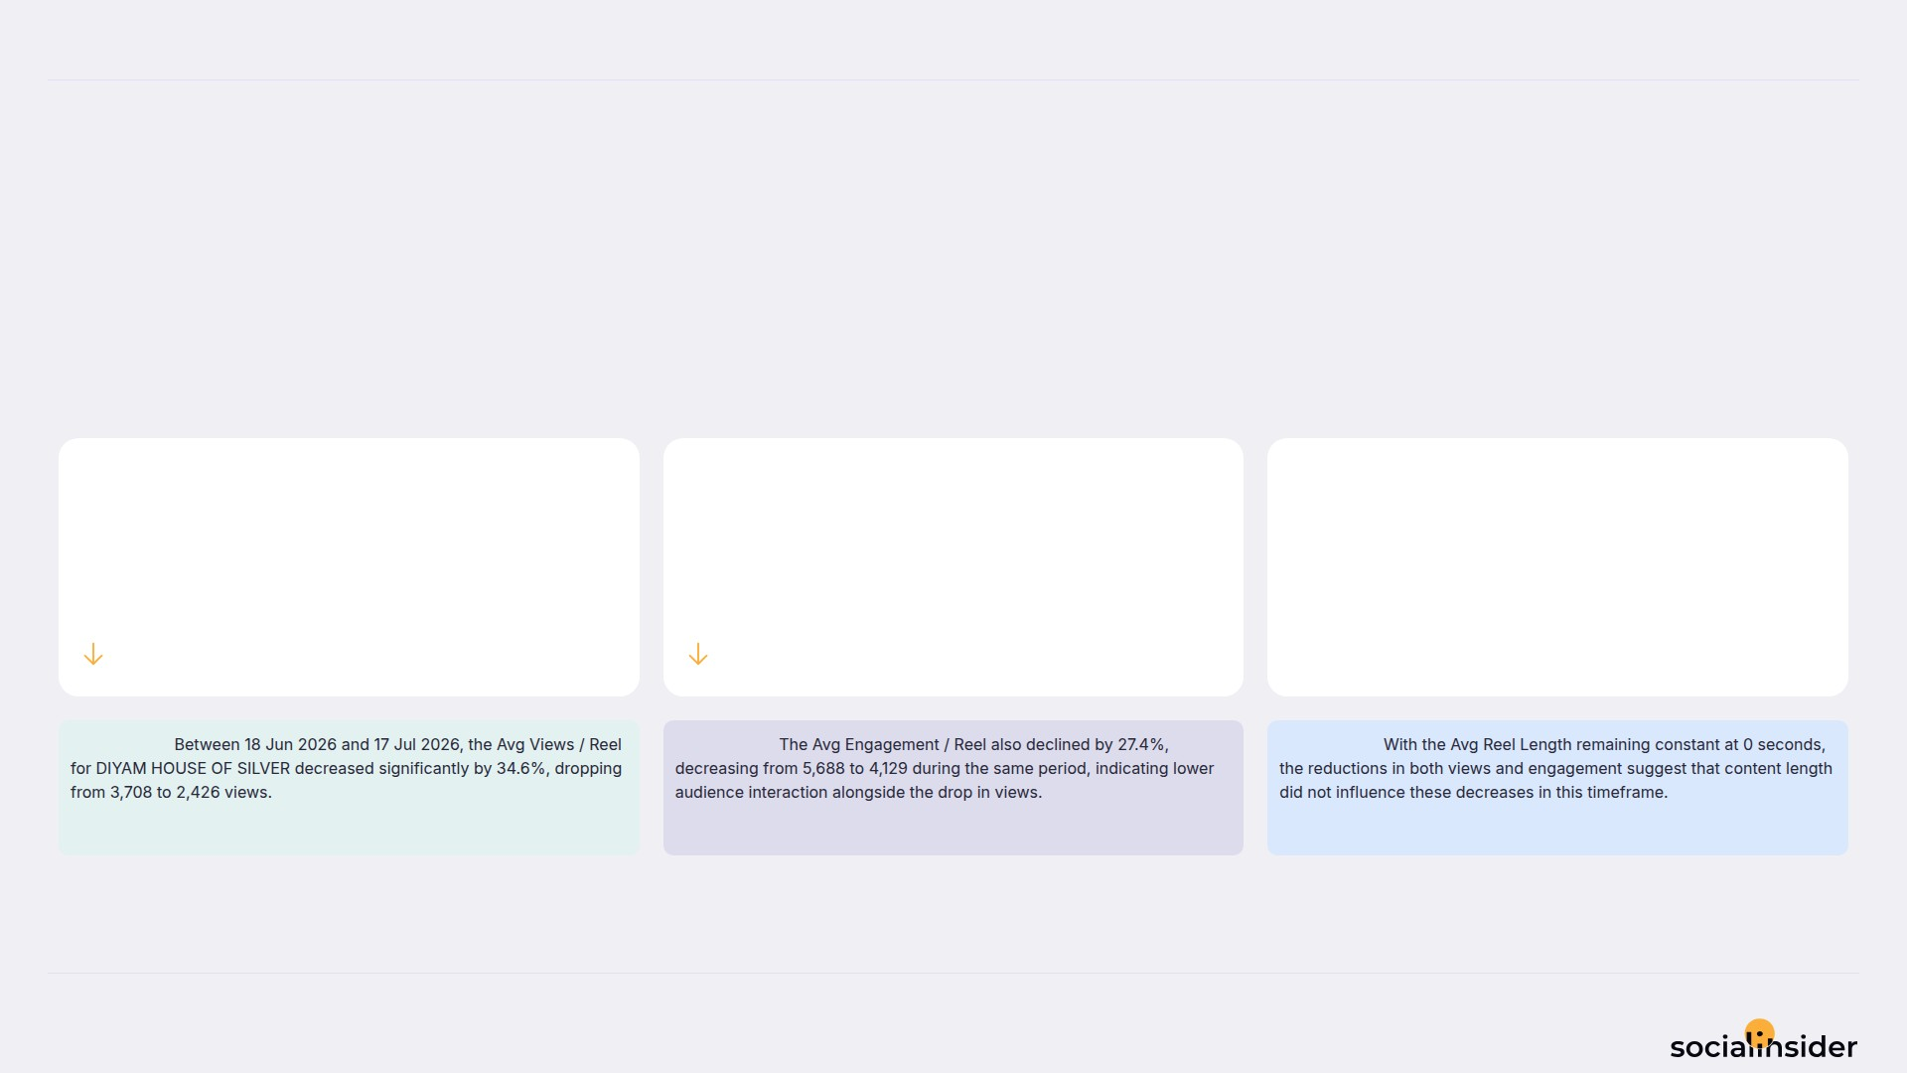
DIYAM HOUSE OF SILVER
REELS
8/12
Key metrics for reels published during the period
Reels was mixed — some metrics increased while others decreased.
AVG VIEWS / REEL
AVG ENGAGEMENT / REEL
AVG REEL LENGTH
2.4
4.1
0
34.59%
27.4%
0%
Observation:
Observation:
Observation:
Source: Socialinsider
Date range: 18 Jun 2026 - 17 Jul 2026

Slide 9
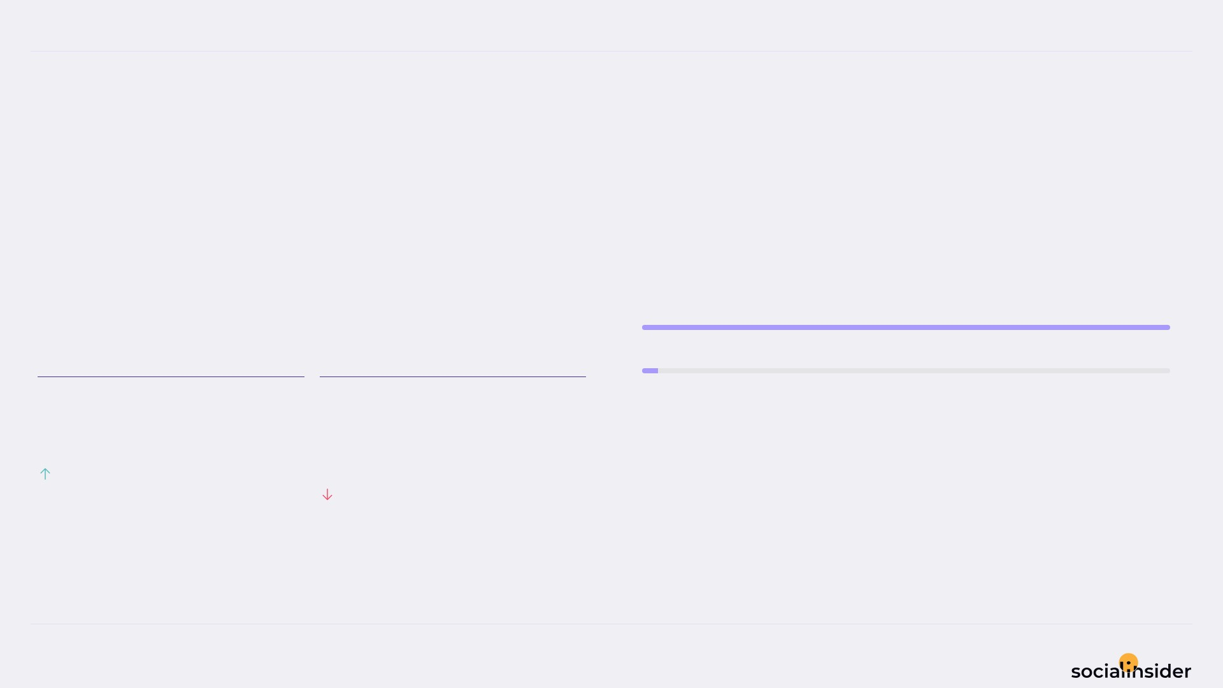
DIYAM HOUSE OF SILVER
REACH
9/12
Reach performance broken down by post type
86.7 Avg Reach / Post — declining this period.
Avg Reach / Post grew but Avg Engagement Rate by Reach dropped — worth monitoring.
Reel
3K
Image
94
AVG REACH / POST
AVG ENGAGEMENT RATE BY REACH
86.7
5.4
%
40.37%
44.35%
Source: Socialinsider
Date range: 18 Jun 2026 - 17 Jul 2026

Slide 10
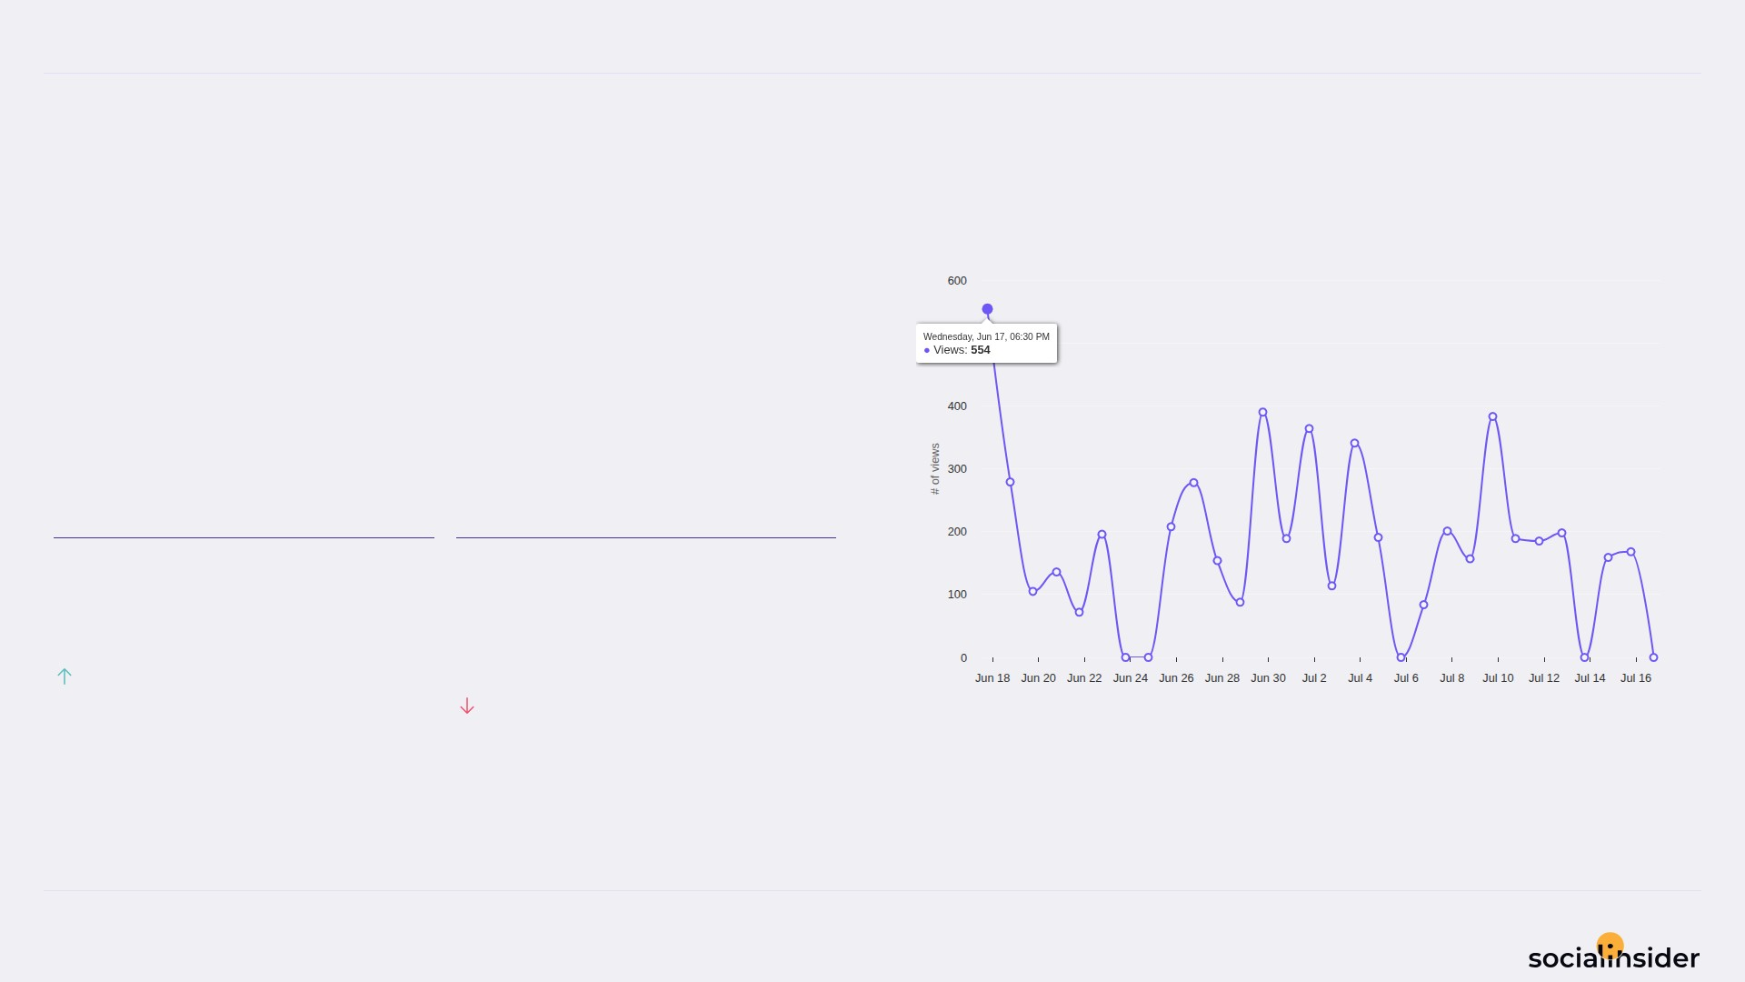
DIYAM HOUSE OF SILVER
VIEWS
10/12
Views performance
138.0 Avg Views / Post — a volatile period.
Avg Views / Post grew but Avg Engagement Rate by Views dropped — worth monitoring.
AVG VIEWS / POST
AVG ENGAGEMENT RATE BY VIEWS
138
3.9
%
93.49%
53.7%
Source: Socialinsider
Date range: 18 Jun 2026 - 17 Jul 2026

Slide 11
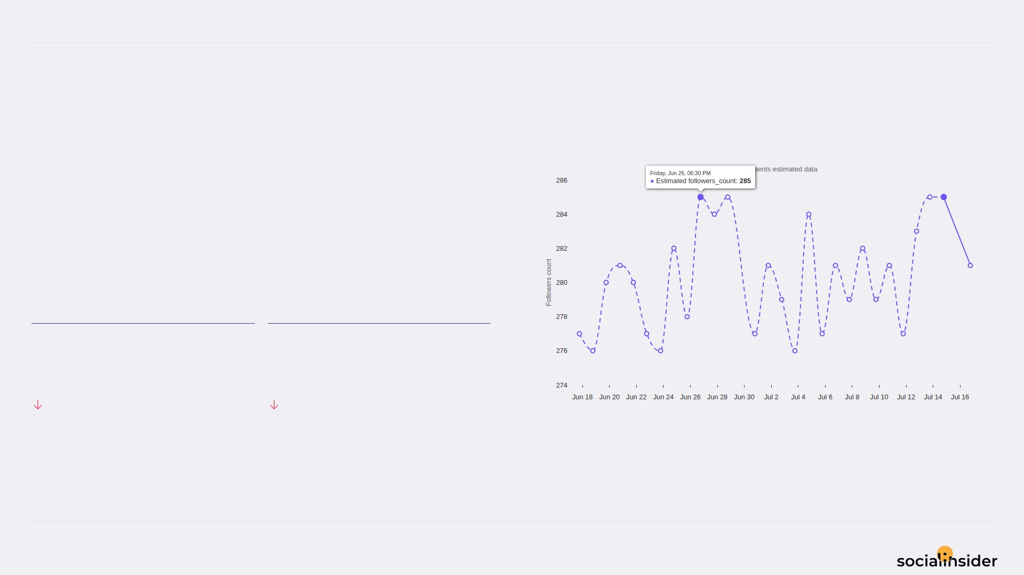
DIYAM HOUSE OF SILVER
FOLLOWERS
11/12
Follower growth trend over the selected period
4 Follower Growth — growth slowing.
Both Follower Growth and Followers Growth % declined this period.
FOLLOWER GROWTH
FOLLOWERS GROWTH %
4
1.4
42.86%
44.71%
Source: Socialinsider
Date range: 18 Jun 2026 - 17 Jul 2026

Slide 12

REFERENCE
12/12
Definitions and reference materials for this report
Glossary & Resources
Scope
Definitions
Resources
Period
Engagement
Socialinsider Blog
18 Jun 2026 - 17 Jul 2026
The sum of likes and comments on the organic posts
socialinsider.io/blog
Comparison Period
Engagement Rate by Followers
Socialinsider Help Center
19 May 2026 - 17 Jun 2026
Engagement divided by follower count, expressed as a percentage
https://howto.socialinsider.io/en/
Social Channel
Reach
Socialinsider Studies
Instagram
Number of unique accounts that saw your content
https://www.socialinsider.io/reports
Content Analysis (posts analyzed)
Views
39
Total number of times your content was displayed
Source: Socialinsider
Date range: 18 Jun 2026 - 17 Jul 2026

